Slide 1
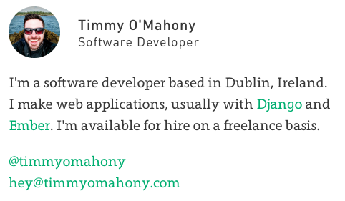
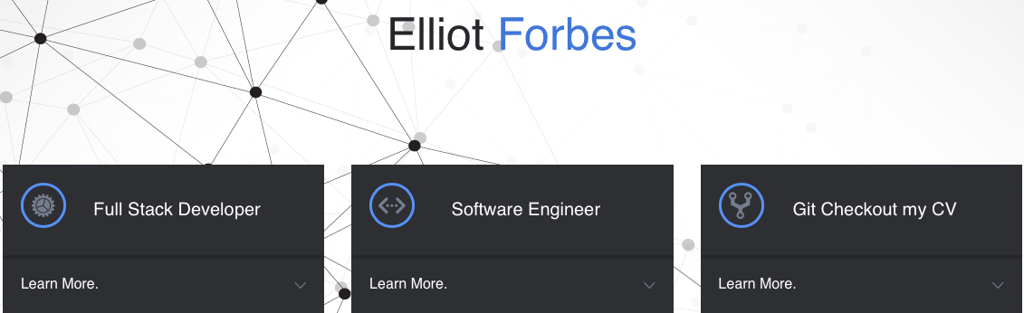
Scott Campbell’s portfolio
A website dedicated to highlighting the work Scott has done to further his education and experience as a computer science student at Michigan State University.
Scott Campbell’s portfolio website will show the viewer a glimpse of his work while being a student a Michigan State in the computer science department. His projects, his work at Fraunhofer, and more will be described through an easy to follow site that will be useful for him to easily show potential employers, faculty, and many others.
Personas
John– Recruiter
Someone looking for a good representation of what Scott has worked on in the past and what he is capable of,
Ryan– Professor
Someone who wants to know know Scott’s current background and what areas he can improve upon in class.
Anna– Advisor
Interested in seeing what Scott has done in his classes and which he may be interested in taking in the future.
Comps
timmyomahony.com
elliotforbes.co.uk

